Slide 1




Climate hazards, the health risk and biodiversity loss predict the existence of climate adaptability policies except for highly vulnerable regions
02 de fevereiro de 2026
Projeto em colaboração entre a Universidade de São Paulo e a Universidade de York

Slide 2
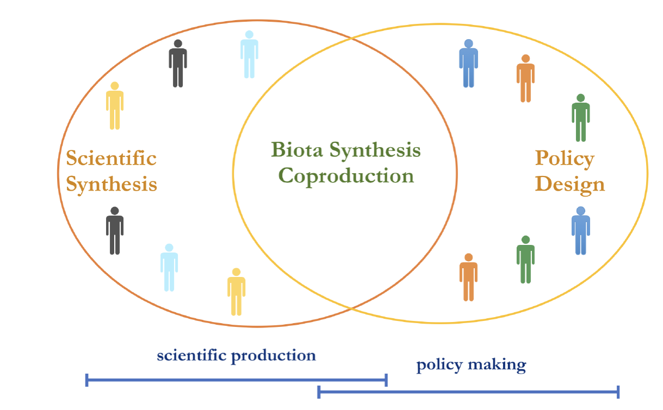
Linking evidence on One Health, Biodiversity and Climate Justice for Climate Adaptation Policy in the State of São Paulo, Brazil
Understanding the use of evidence in policymaking
Identify the constraints and enablers around effective integration of scientific evidence into climate adaptation policy.
Understand effective evidence utilization mechanism, by identifying ways of thinking using Q-methodology and generate recommendations.
Promote addressing of interconnected environmental and health challenges, by gathering and using biophysical and social data related to climate adaptation.
University and Institutions in São Paulo
Environmental, Agricultural and Health state agencies in São Paulo
Building up on previous
transdisciplinary experience

Slide 3
How is the use of evidence for policy making understood by the stakeholders involved?
A review on the main barriers and enablers of how evidence is incorporated into policy making (with special attention into climate actions plans). Based on this literature review a set of ~60 statements were produced to generate the Q-set statements to assess stakeholders' profile during a workshop that will take place at the end of February. Here are some statement examples regarding pathways:
Expertise to collect, interpret or apply evidence amongst agents, particularly in the climate adaptation sector, is required for a good use in policymaking.
Programs at the organizational level (for example, regulatory, governance and accountability), that integrate different scales (municipal, state and national) and focus areas (agricultural, environmental, and urban) are required for a good use of evidence in policymaking.
Platforms and repositories facilitate making information available to policymakers.

Slide 4
We aim to explore:
If evidence on climate impacts driving policies implementation?
1) Municipalities with greater socio-environmental risks (health, climate hazards, social vulnerability and biodiversity crisis) are also the regions with greater urban adaptability index?
Put differently:
1) The current instrumental adaptive capacities of municipalities ensures the provision of ecosystem services? 1.1) are these service equally distributed among different sectors of society (environmental justice)? 2) Can municipalities adaptive capacities contribute to reduce or alleviate environmental risks through biodiversity conservation?

Slide 5
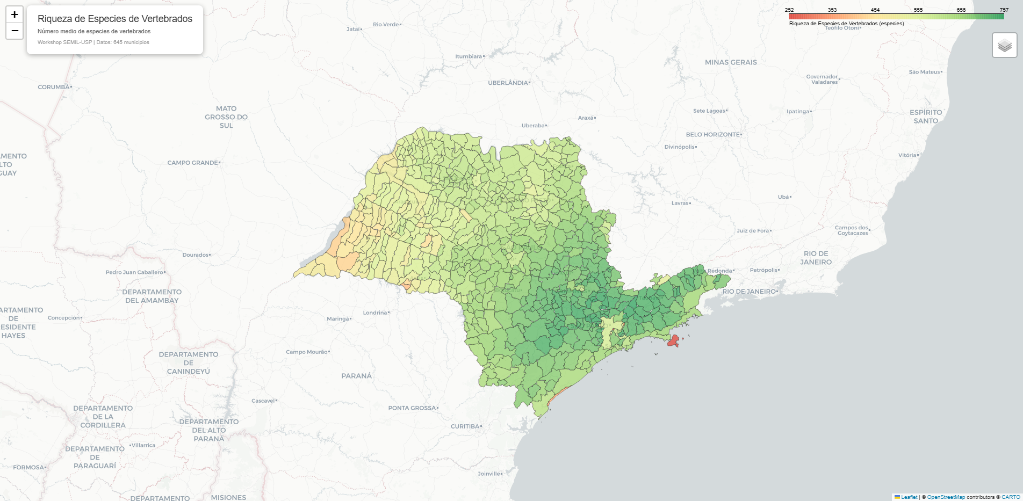
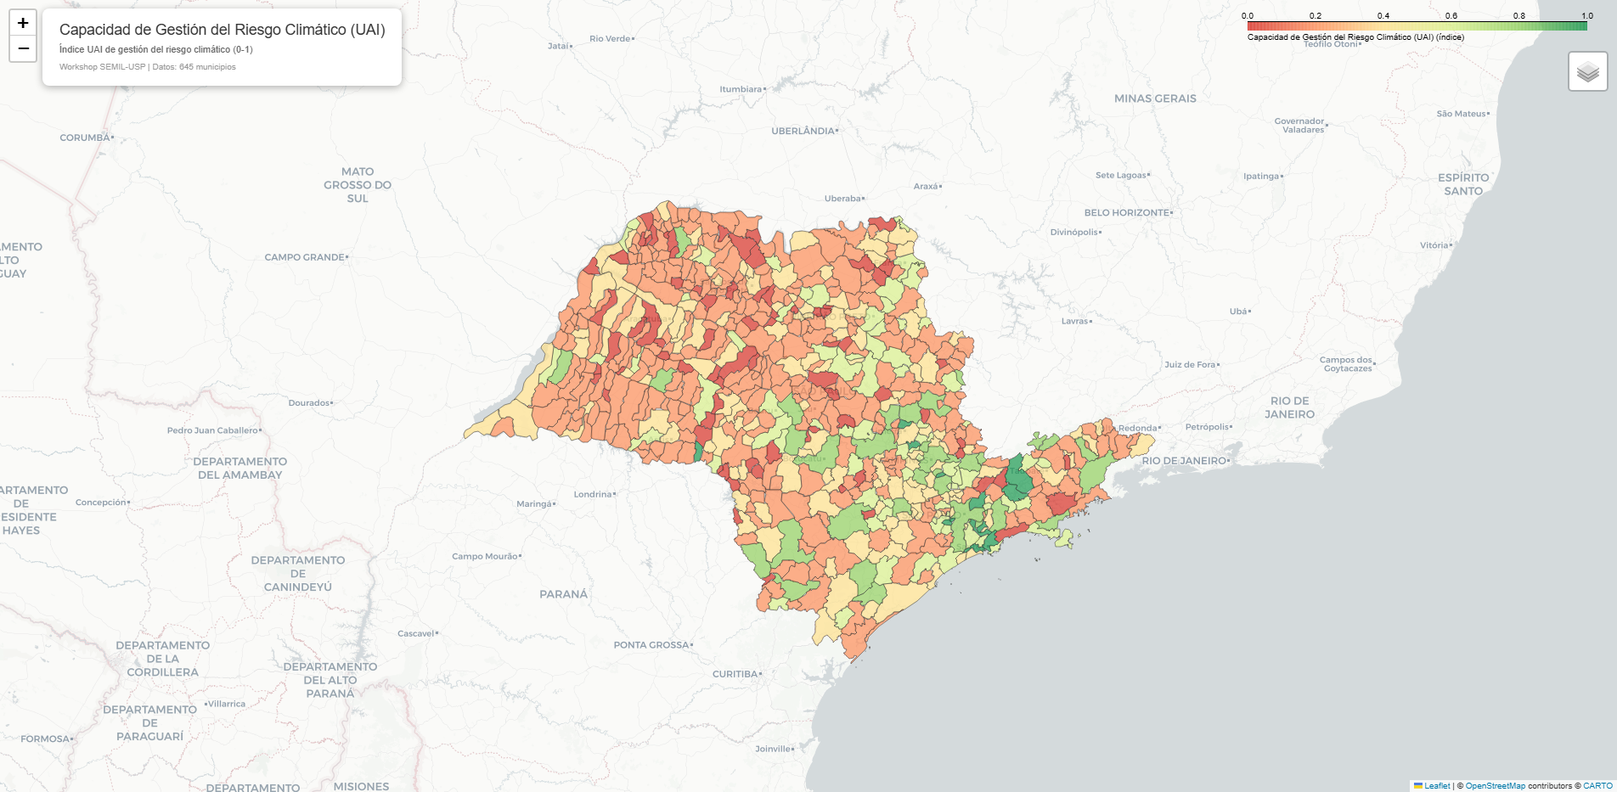
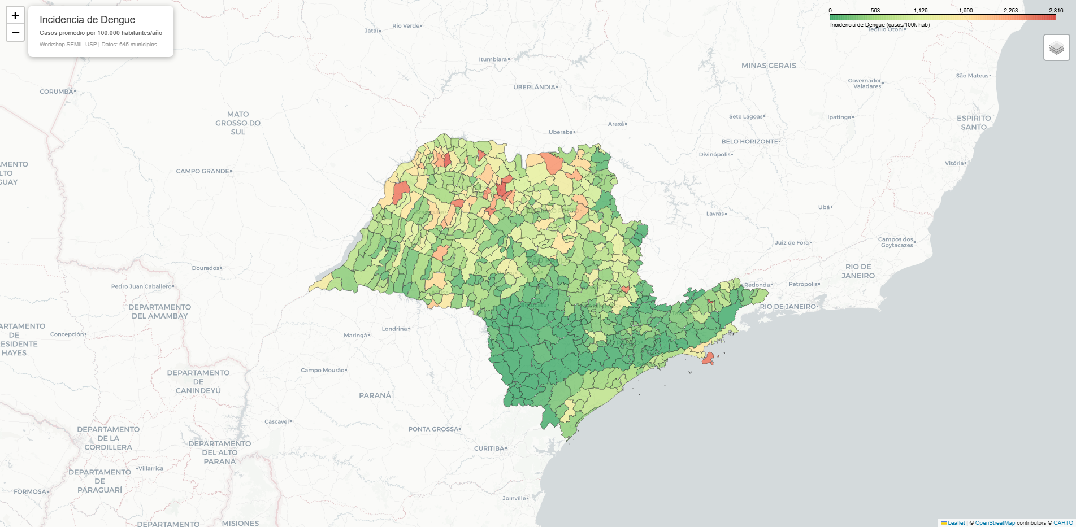
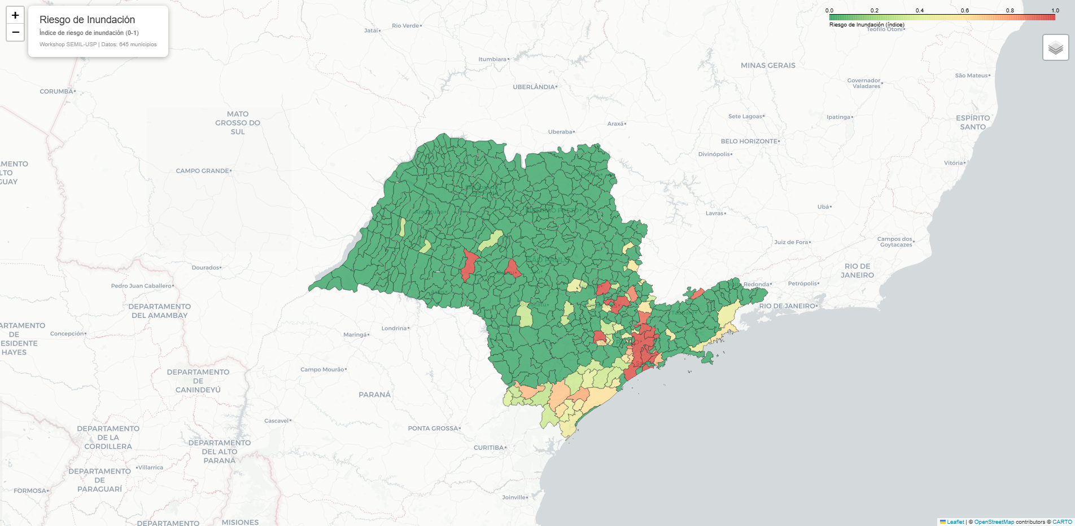
We aim to explore:
a) Vertebrate richness
If evidence on climate impacts has been driving policies implementation?
OR, if municipalities with greater socio-environmental risks (health, climate hazards, social vulnerability and biodiversity crisis) are also the regions with greater urban adaptability index?
b) Dengue incidence
c) Flooding risk

Slide 6
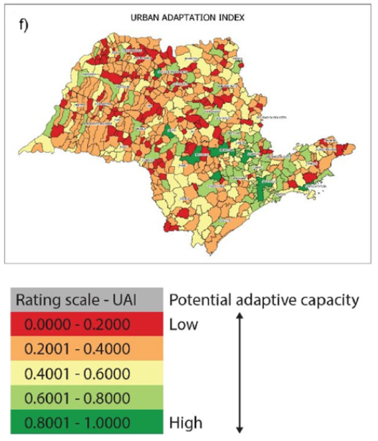
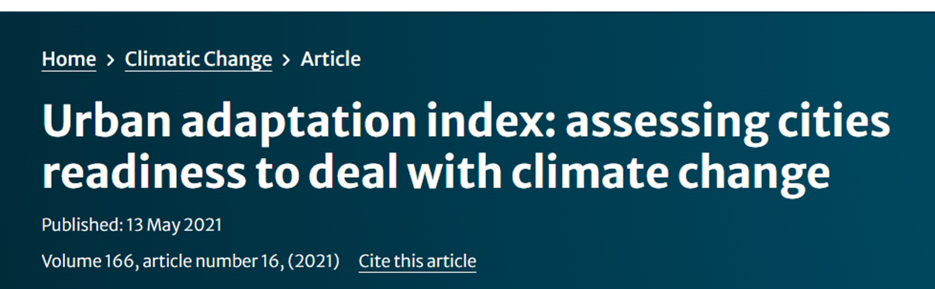
What policies are in action?
We will integrate 26 indicators of public policies that support interventions related with climate adaptation. The urban adaptation index (UAI) are grouped within 5 dimensions, each of which will be directly link to specific ecosystem service of climatic hazard events:
Climate impact response
Environmental management
Housing
Climate adaptation capacity
Sustainable agriculture
Urban mobility

Slide 7
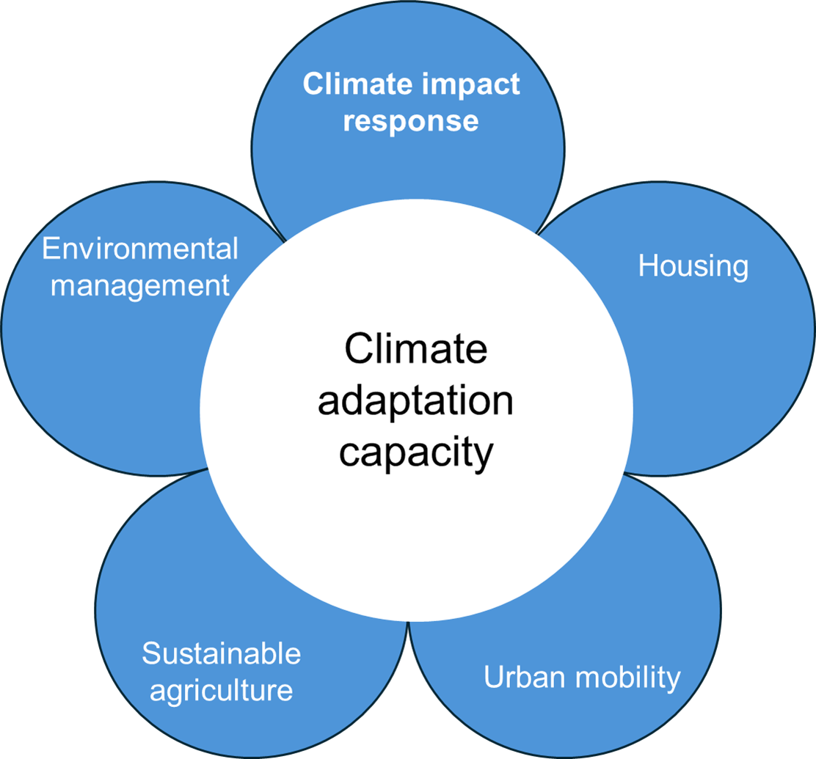

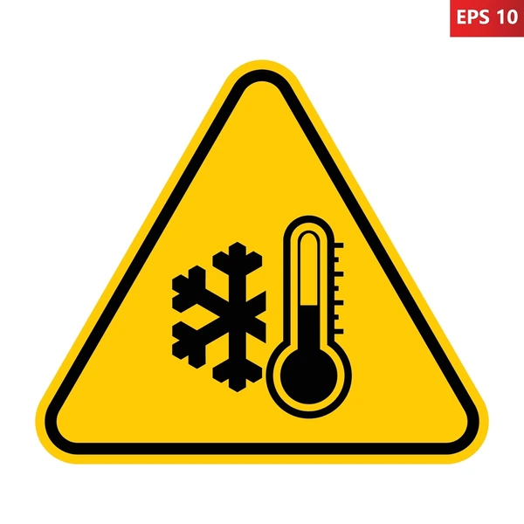

Study scope and aim:
The presence of climate change adaptation policy is associated with the provision of biodiversity mediated services?
Are ecosystem services and policies equally distributed across socially vulnerable sectors (environmental injustice)?
Social Vulnerability
Climate hazards
Health benefits
Related outcomes:
Health benefits ↔ Disease and death
regulation
- Climate hazard regulation/prevention
- Environmental justice ↔ social vulnerability

Slide 8

What is driving climate change adaptability policies?
Picture from:: Climate promise - UNDP

Slide 9
## 7.2 Evidencia de Gobernanza Reactiva
Los resultados apoyan la **inversión de la lógica causal**:
1. **Riesgos climáticos** (fuego, inundación) están **positivamente** asociados a gobernanza
2. **Dengue** también muestra relación **positiva** con gobernanza
3. Esto sugiere que los municipios desarrollan capacidad adaptativa *en respuesta* a eventos adversos, no preventivamente 4. Sin embargo la vulnerabilidad social no es un riesgo contemplado en la elaboración de la capacidad adaptativa.

Slide 10
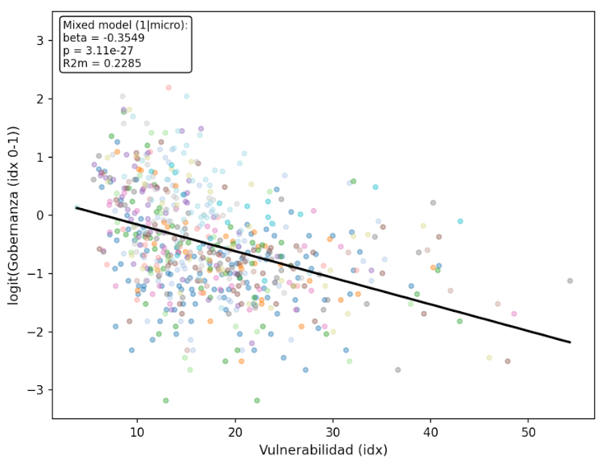
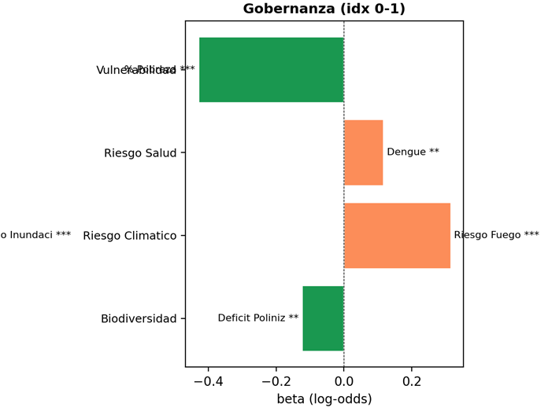
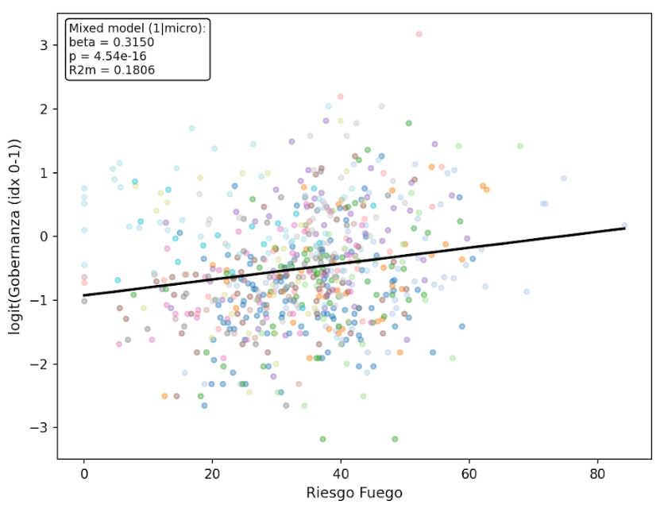
What predicts policies presence within each dimension of socio-environmental risk?
27%
12%
18%
11%
Seemingly Urban adaptability policies are in place where fire climatic risk are greater (specially for fire risk) and where biodiversity is lower, and higher health problems are, specifically where dengue threats are greater. Yet the socio-economically vulnerable are being excluded, have less urban adaptability policies.

Slide 11
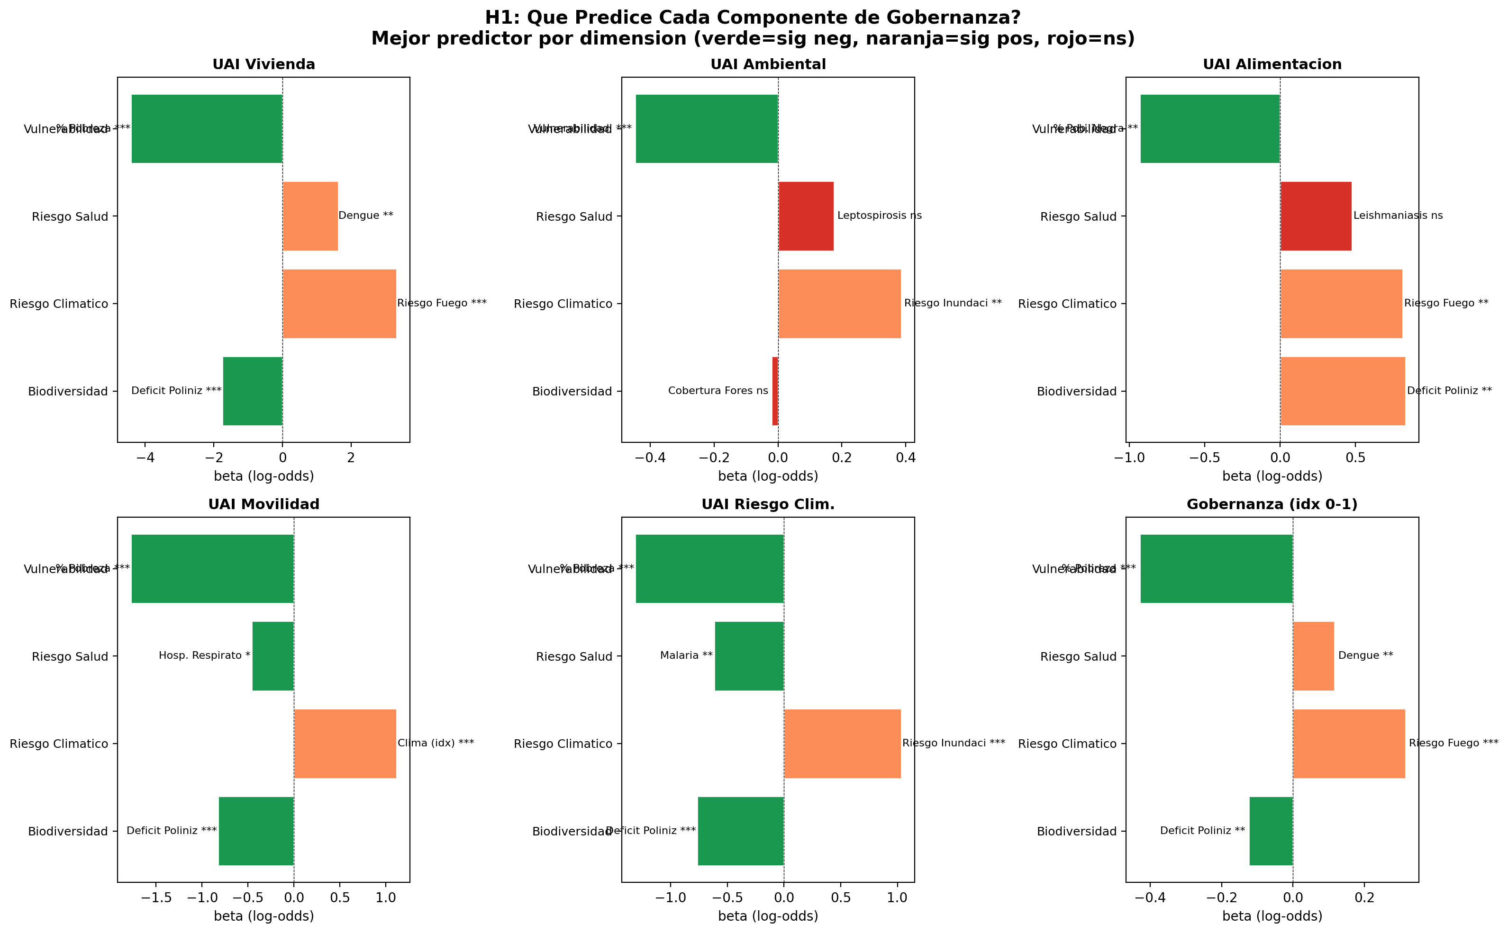
Is is the same for all the Urban adaptability components??
1
2
3
4

Slide 12
1) Injustiça climática
Poverty is the single most relevant predictor of governance.
Maybe due to the poorest municipalities having fewer resources to invest in infrastructure and management?

Slide 13
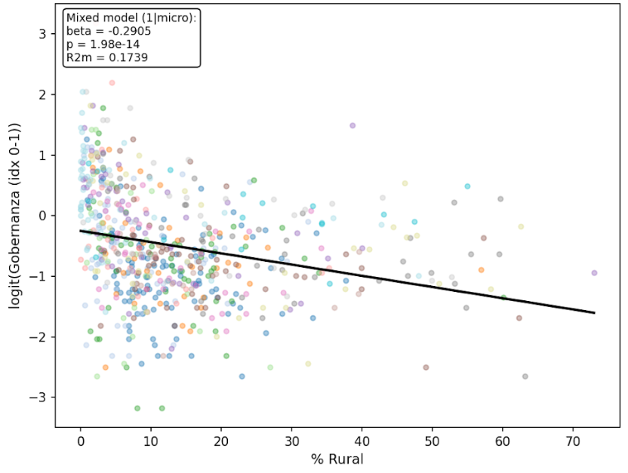
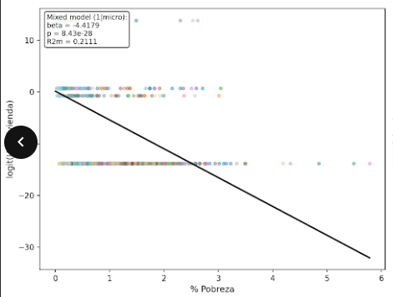
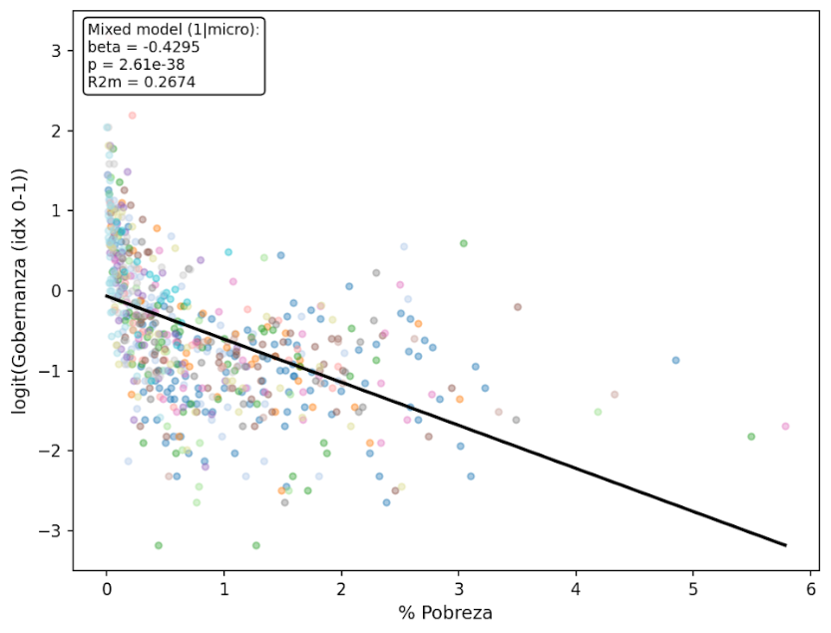
Poverty Is associated to rural municipalities showing similar trends for housing and mobility
1) Injustiça climática
Evidence of climate injustice – higher social vulnerability takes places in municipalities that have the lowest Urban adaptation index
Which of the Governance index components is more strongly associated to vulnerability index?
What is the vulnerability index component that best predicts governance? But also, is lower in more rural municipalities?

Slide 14
2) Foco em extremos climáticos
Climate index***
Flooding risks***
Fire risk***
Municipalities with greater climate risk have better governance.
This positive correlation leads us to ask: Is governance reactive or proactive? It often happens that municipalities develop adaptive capacity after experiencing climate risks. This is in response to adverse events, not preventively.

Slide 15
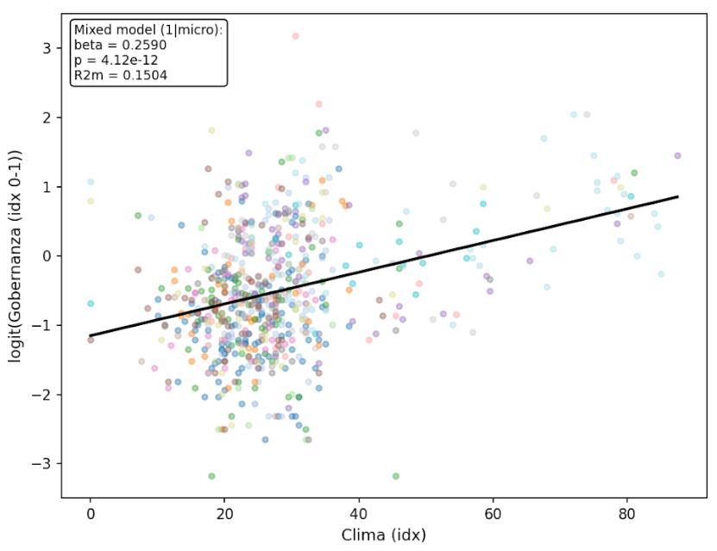
2) Foco em extremos climáticos
Higher climatic extreme events, the higher the likelihood that those municipalities has climate adaptation policies, but are they proactive or reactive?

Slide 16
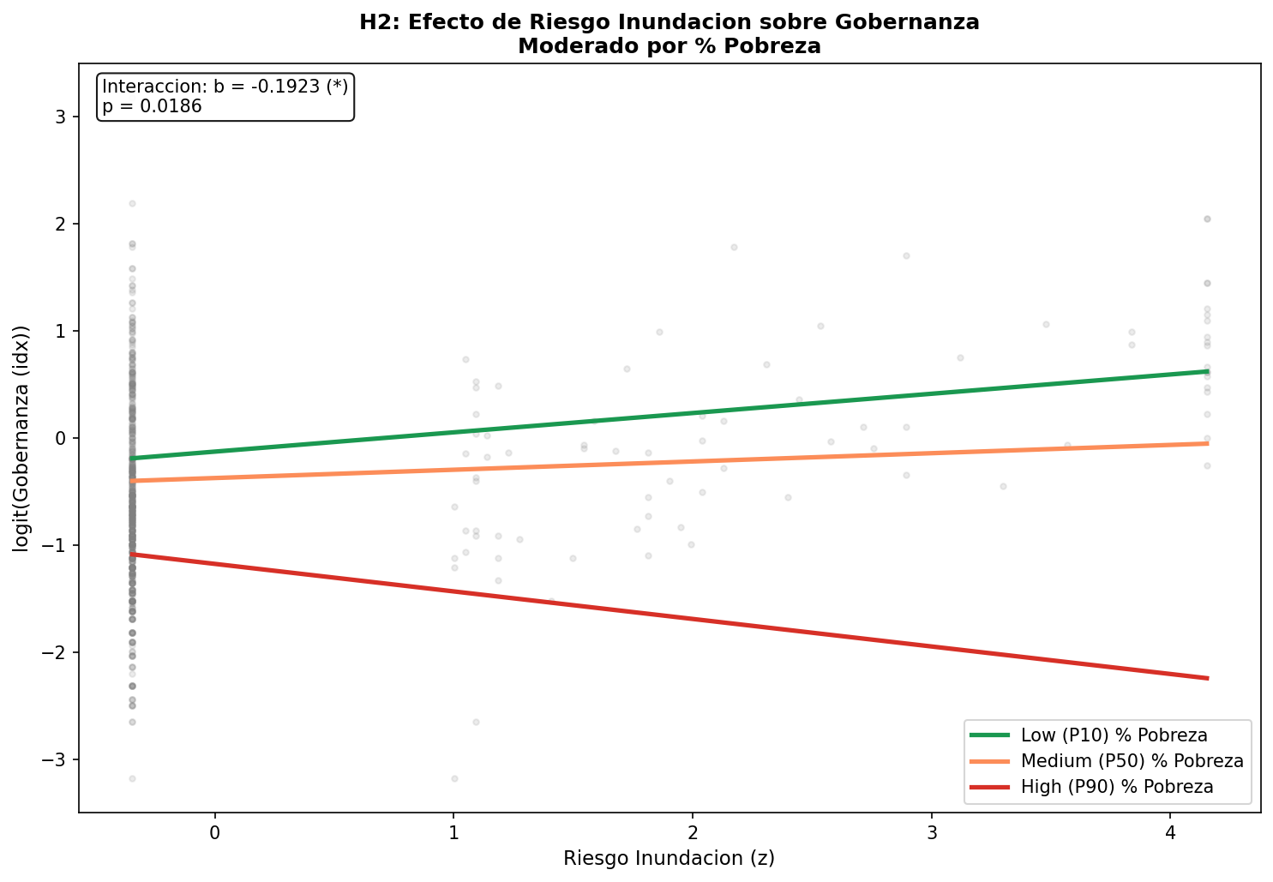
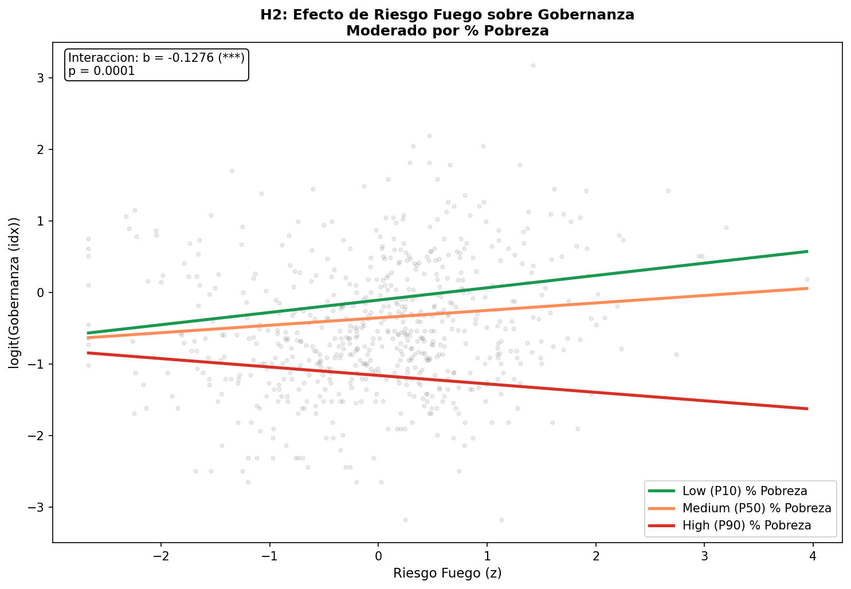
2.2) Foco em extremos climáticos e pobreza
The reactive climate adaptive policies, seems to be exclusive for municipalities that have lower proportion of poverty.

Slide 17
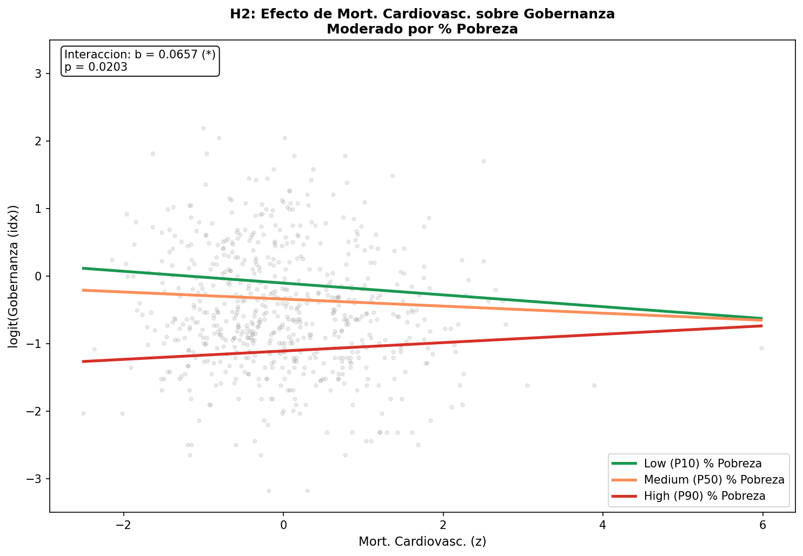
3) Foco em Saúde
More worryingly, there is a lack of climate adaptation in municipalities with higher health death due to cardiovascular disease and where population is more vulnerable.
Summary: Poverty consistently attenuates the effect of governance risks, except for cardiovascular mortality where it amplifies it.

Slide 18
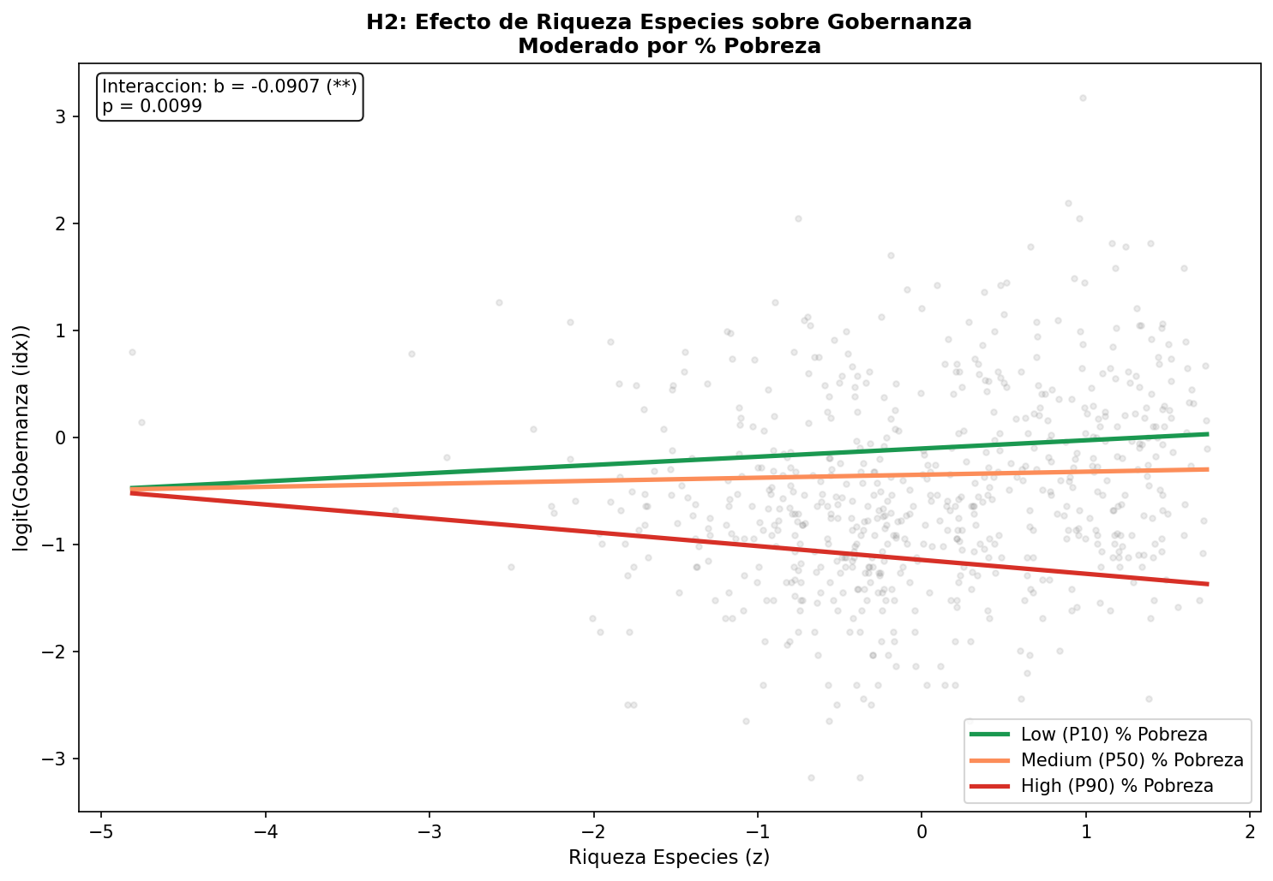
4) Foco em Biodiversidade
Biodiversity as an Indirect Indicator
Pollination deficits reflect environmental degradation associated with:
- Marginal areas with less public investment
- Areas with less institutional development
- A possible proxy for territorial abandonment

Slide 19
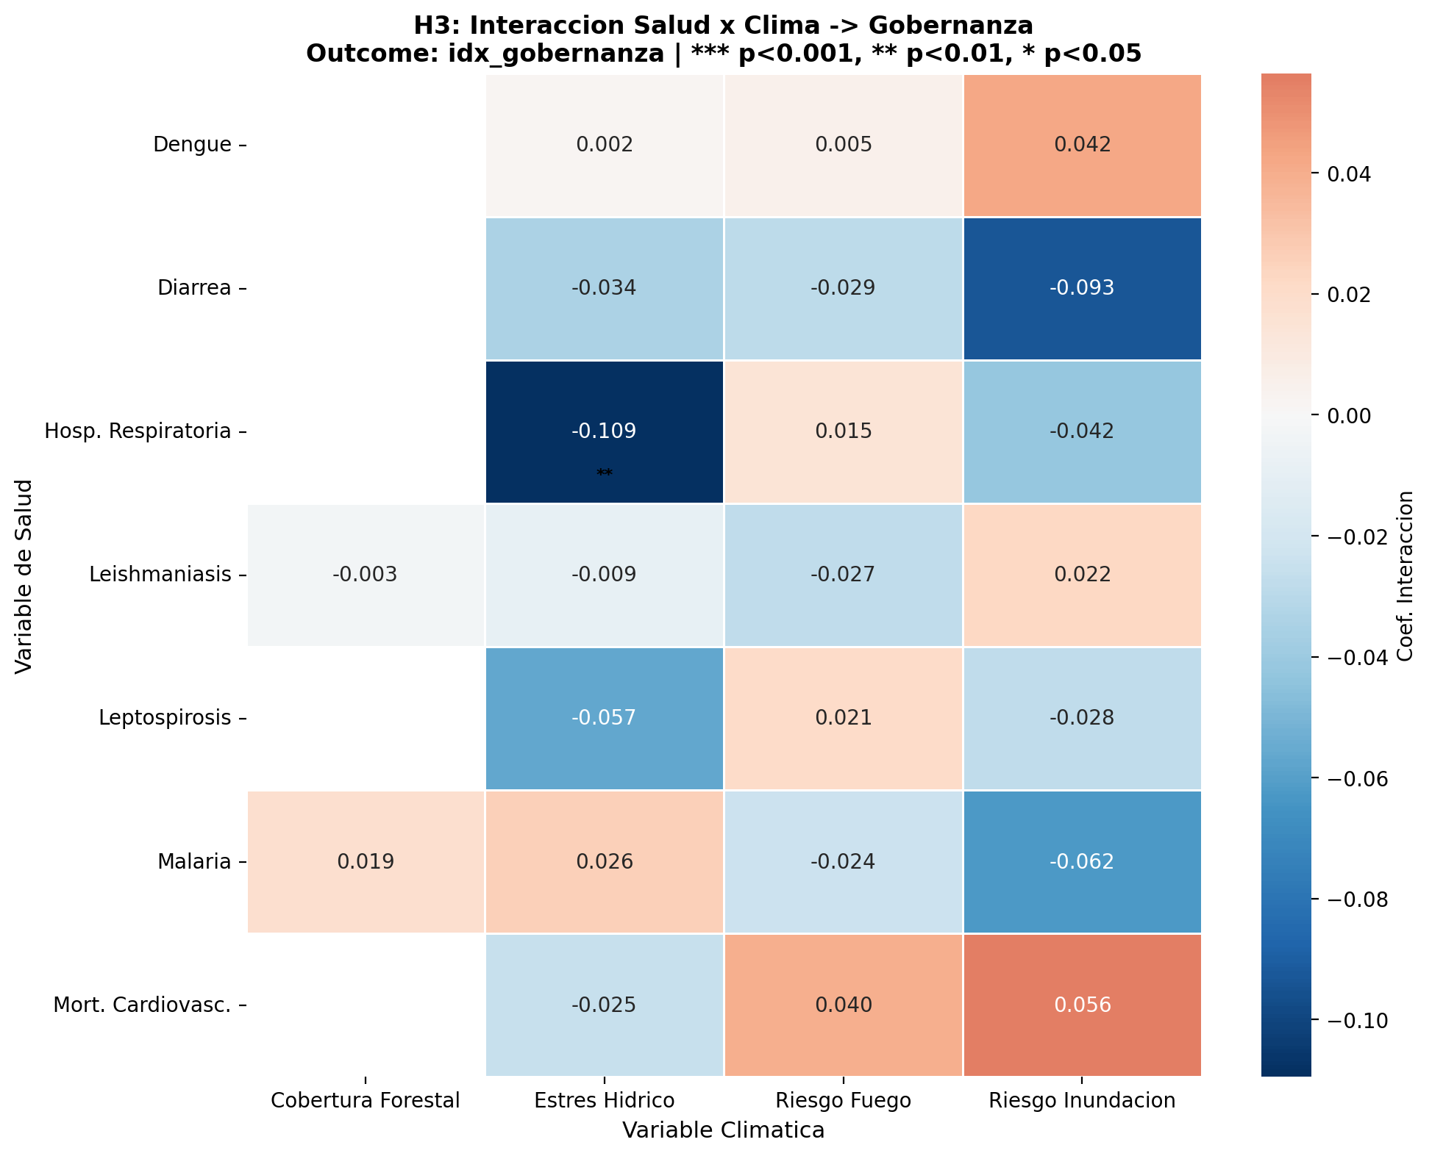
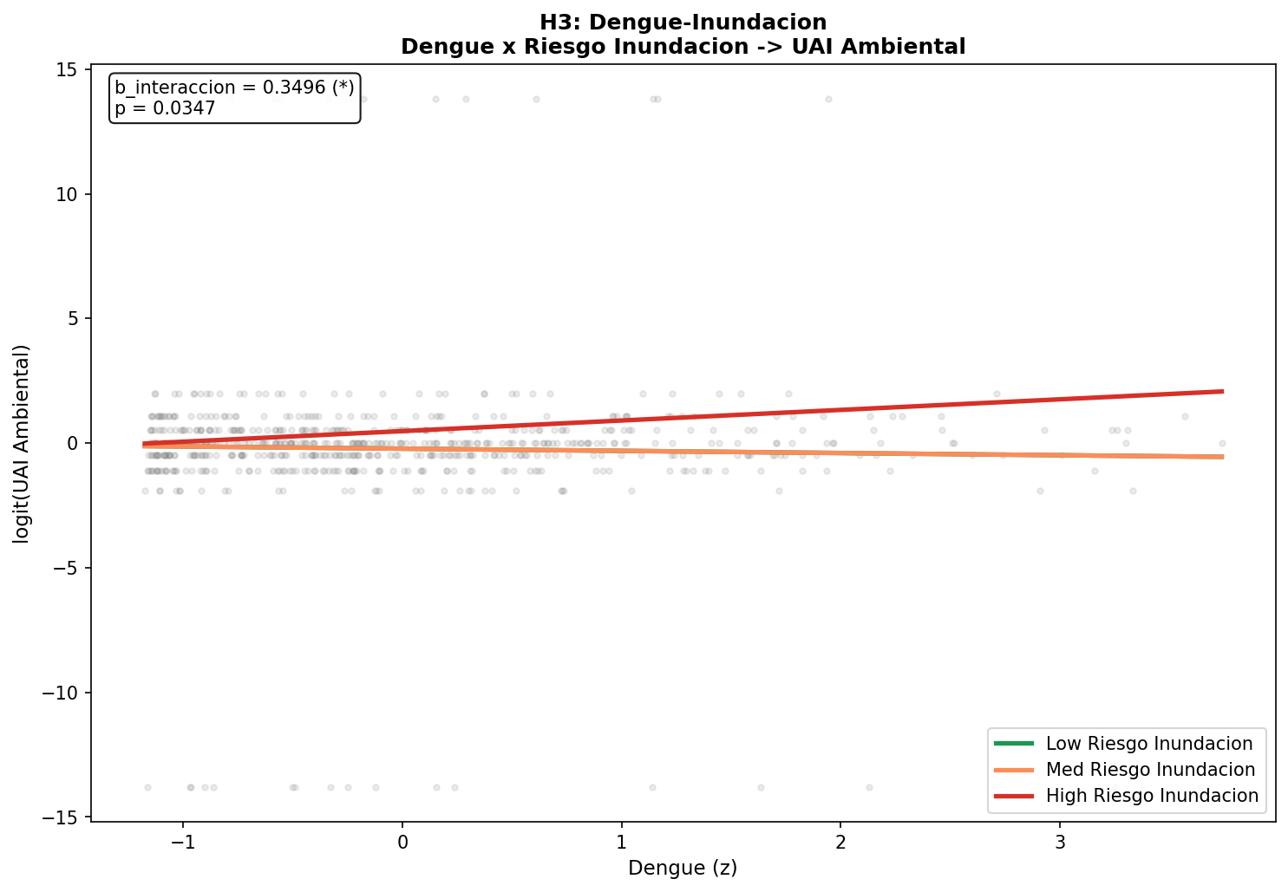
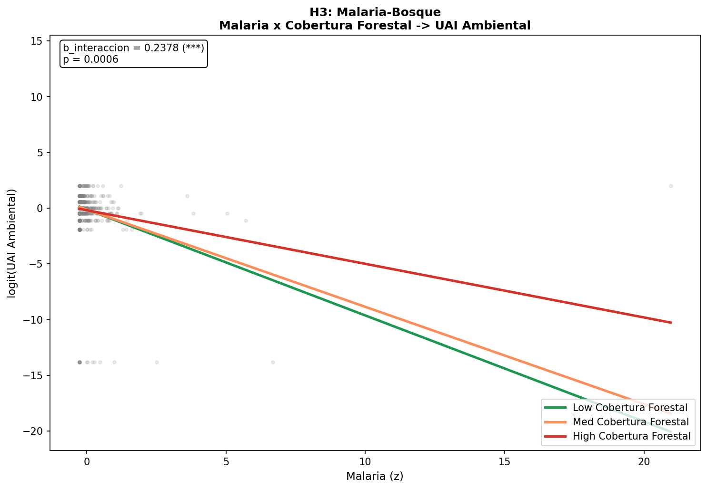
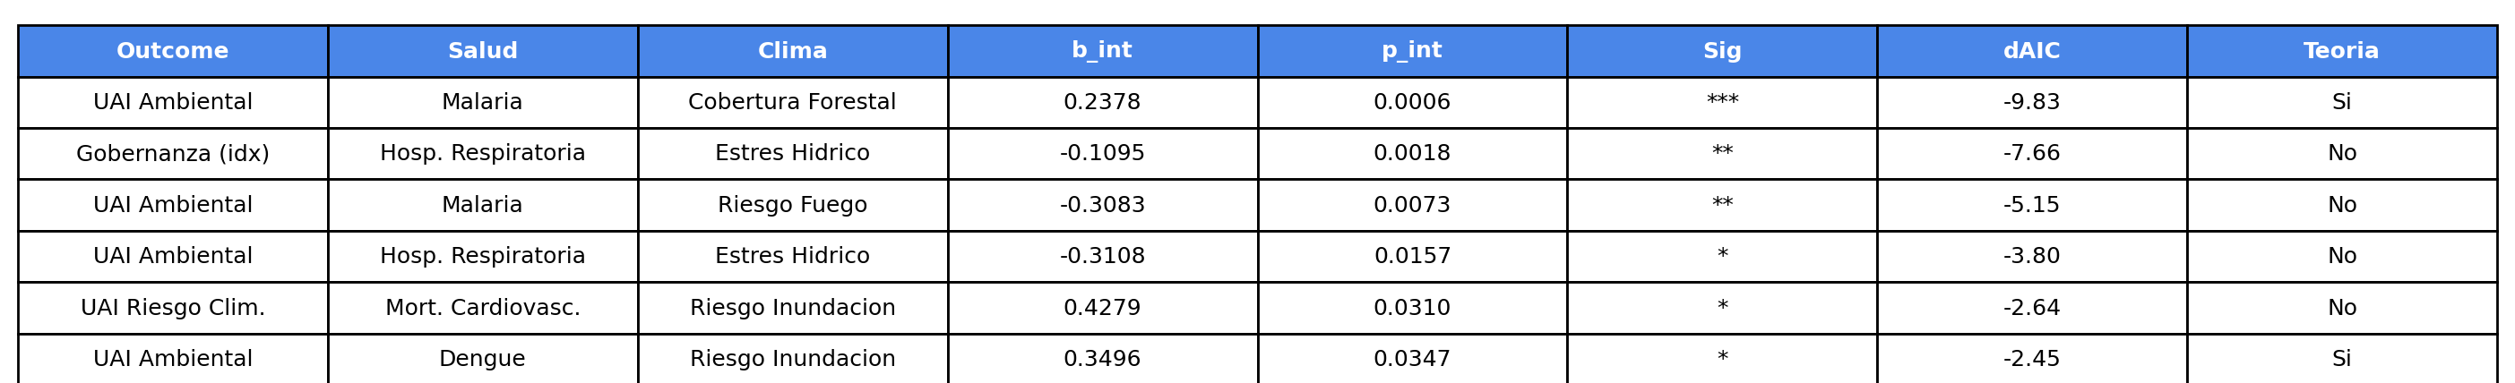
5) Interação saúde e clima na gobernança
Extream dry season relates to respiratory disease in places that have urban adaptability policies, specially from the environmental dimension
Flooding might me associated to heat_stress regions which might explain the relationship to heart disease in places with higher Climatic governance

Slide 20
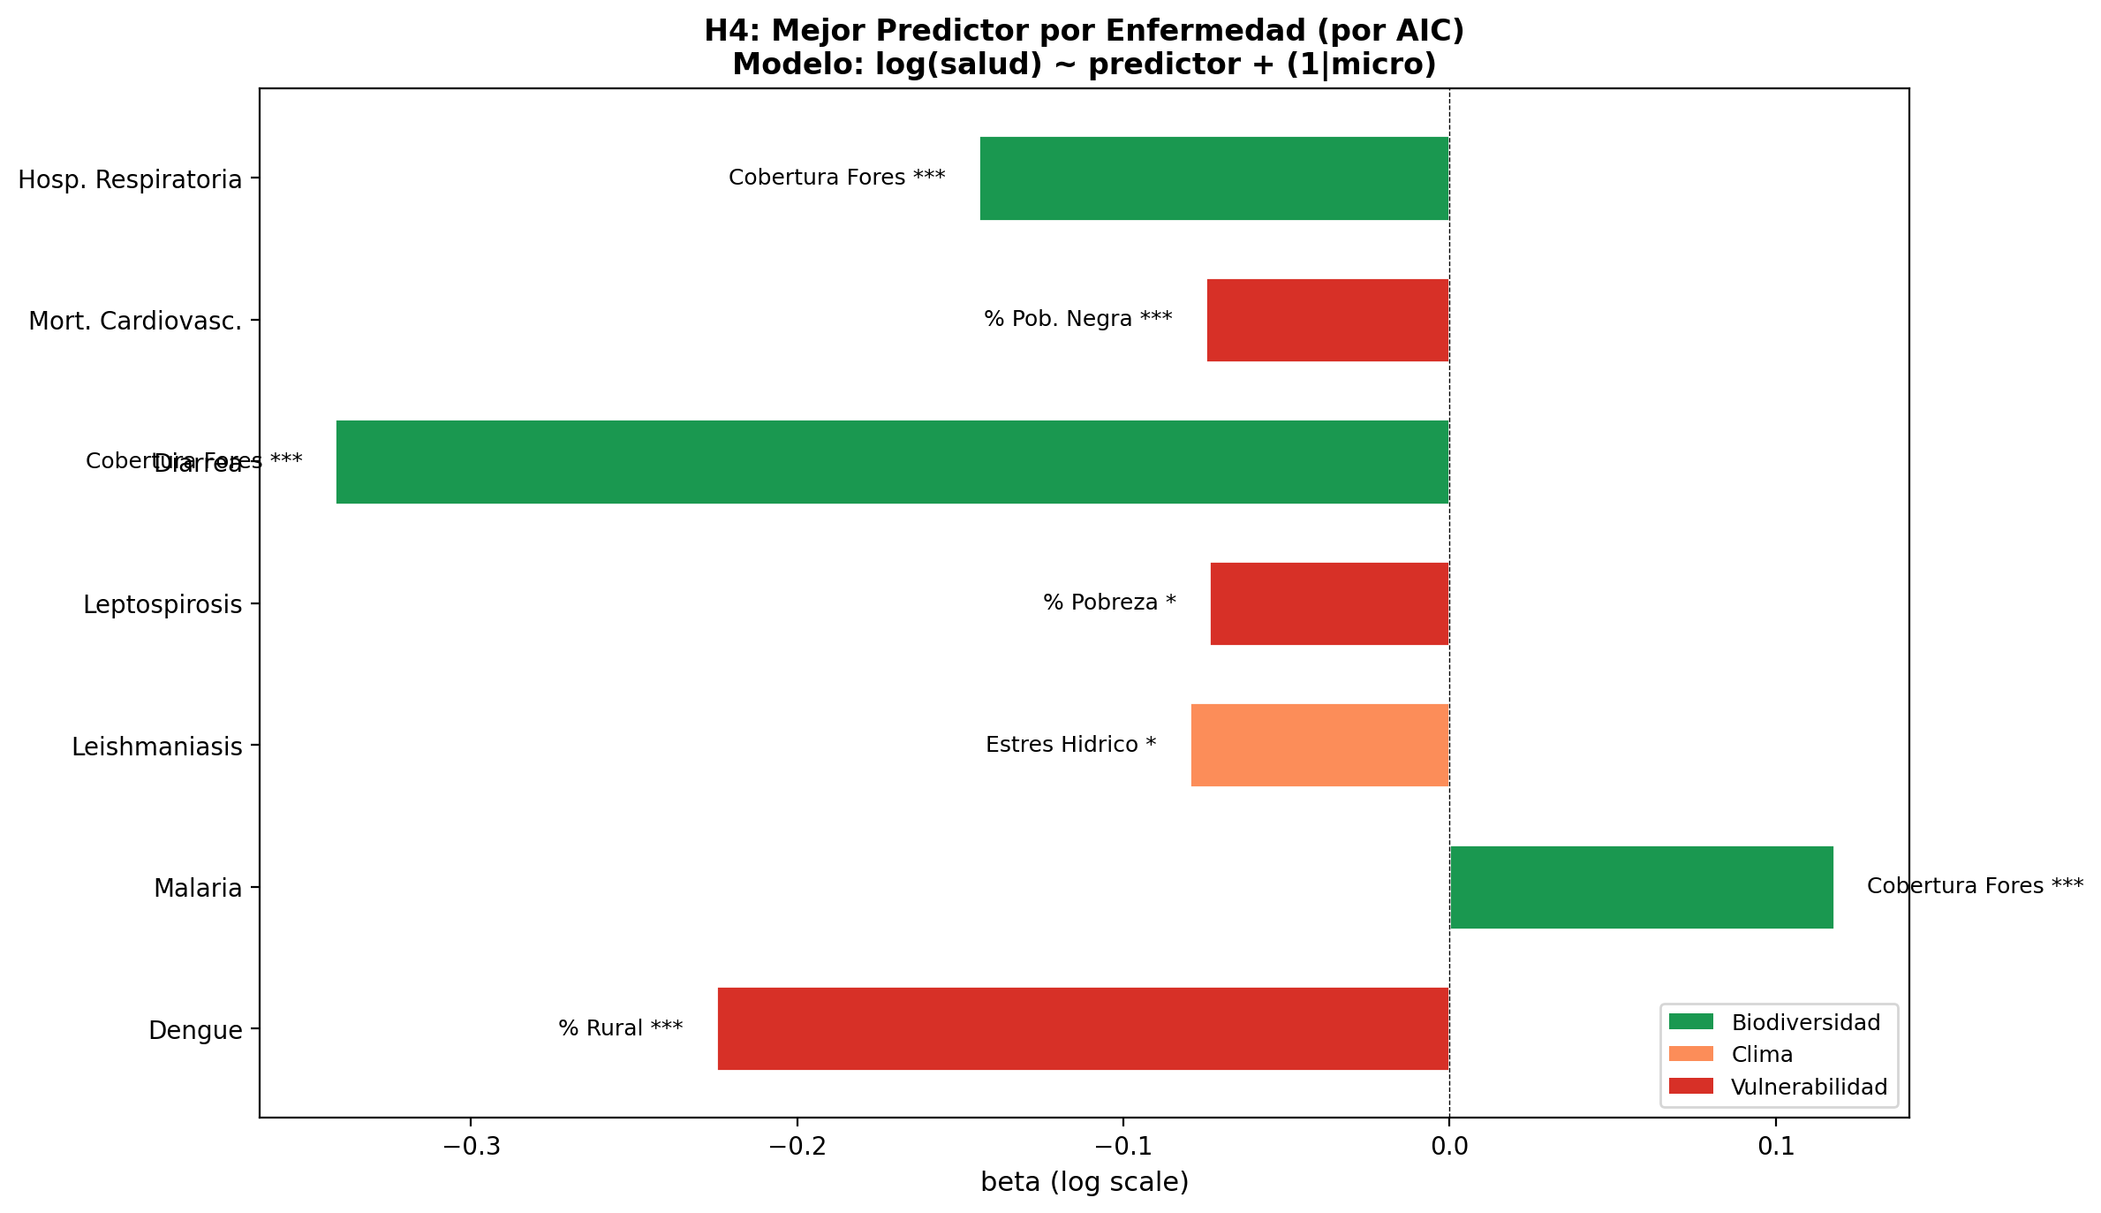
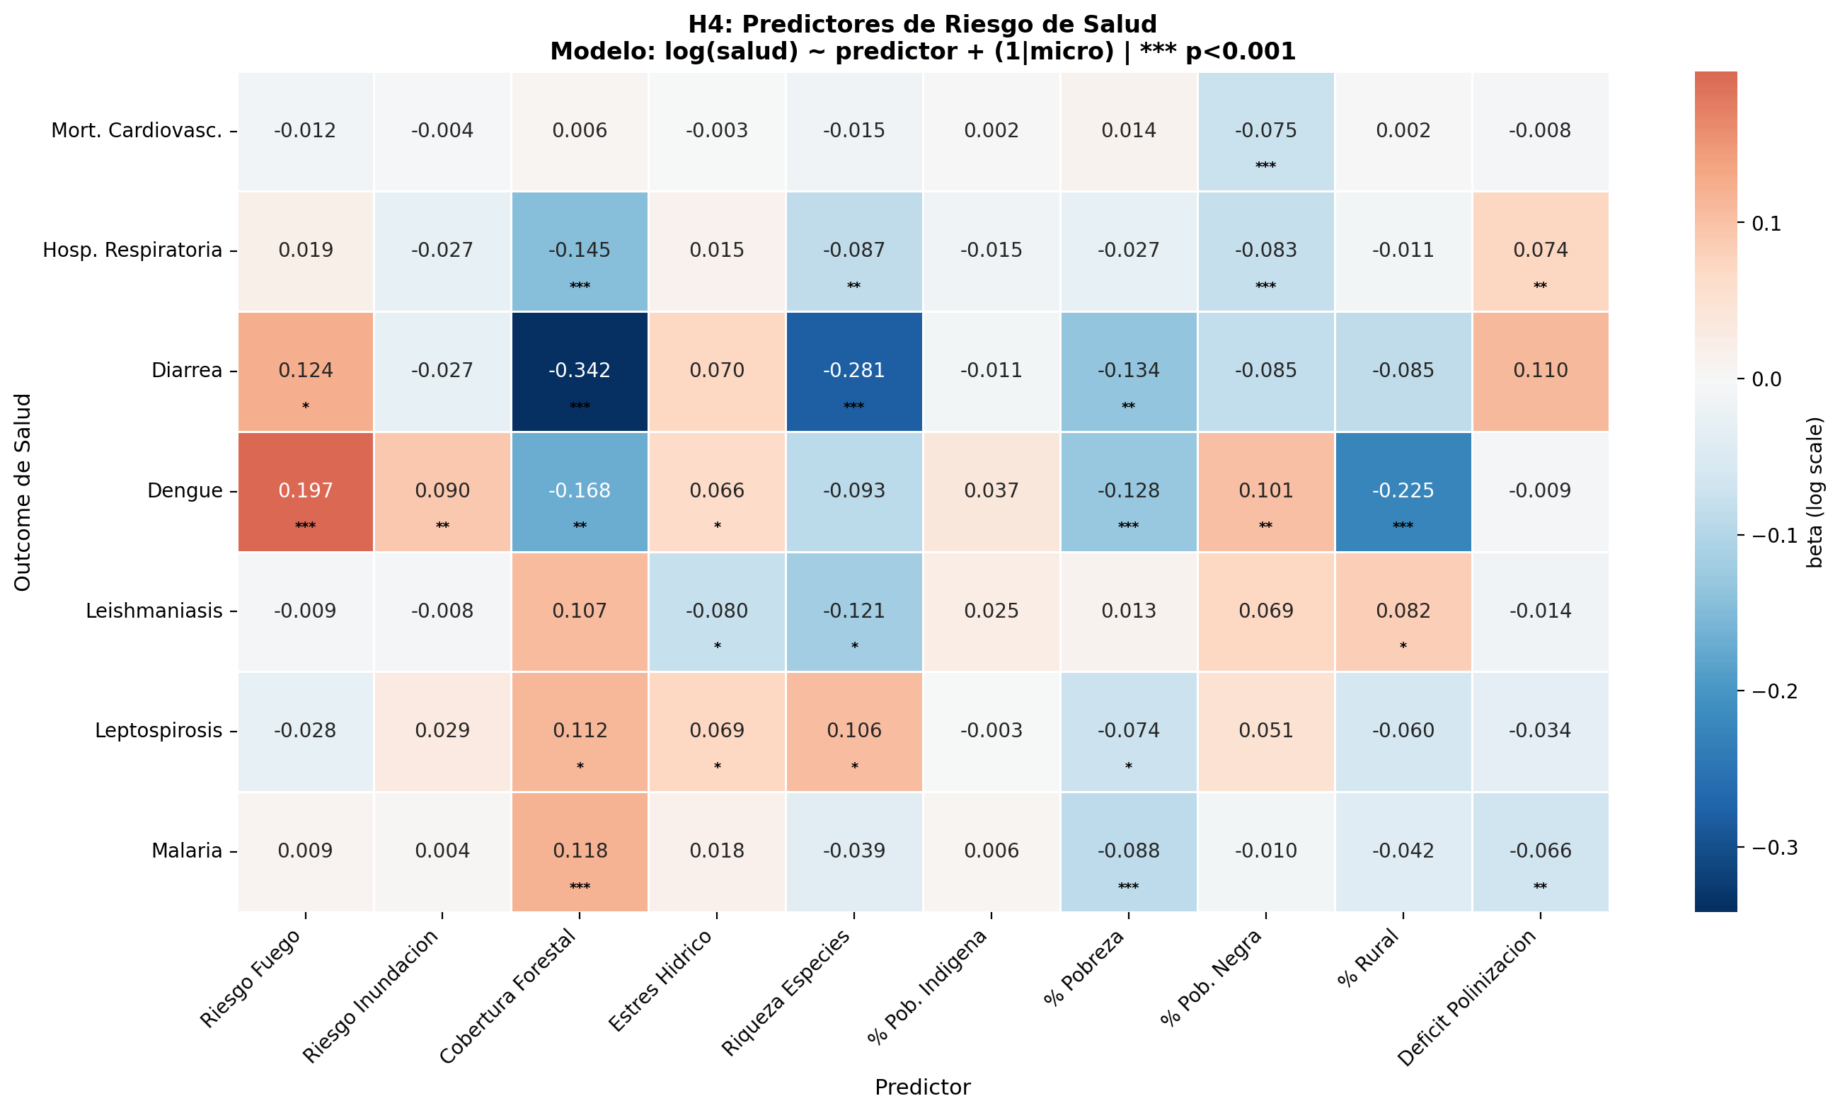
6) Quem prediz os riscos de saúde?
Forest cover is a better predictor than species richness, suggesting that it is habitat structure (not diversity per se) that matters for disease vectors.
Important note: The negative signs for poverty and Black population percentage likely reflect:
- Reduced access to diagnosis and reporting in vulnerable populations
- Underreporting in marginalized areas
- Possible survivorship bias (people die before being diagnosed)

Slide 21
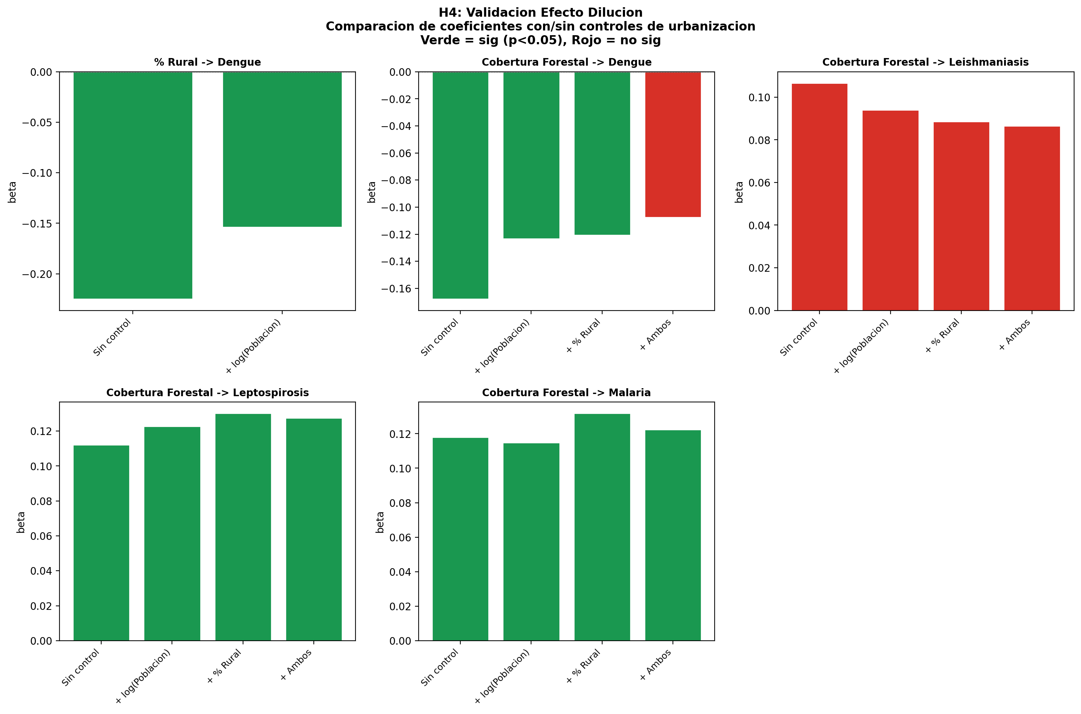
6) Interação saúde e ambiente
La cobertura forestal es mejor predictor que la riqueza de especies, sugiriendo que es la estructura del hábitat (no la diversidad per se) lo que importa para los vectores de enfermedades.
Dengue: El efecto aparente de cobertura forestal desaparece al controlar por población/ruralidad. El verdadero predictor es % Rural.
Malaria: El efecto de cobertura forestal es robusto y biológicamente plausible (hábitat del vector).
El efecto de bosque sobre leishmaniasis no es estadísticamente significativo. El mejor predictor es estrés hídrico (β = -0.08).
Explicación ecológica: La malaria requiere ecosistemas forestales para el ciclo de vida del vector (Anopheles). Este es un efecto biológico real, no un artefacto de urbanización.

Slide 22
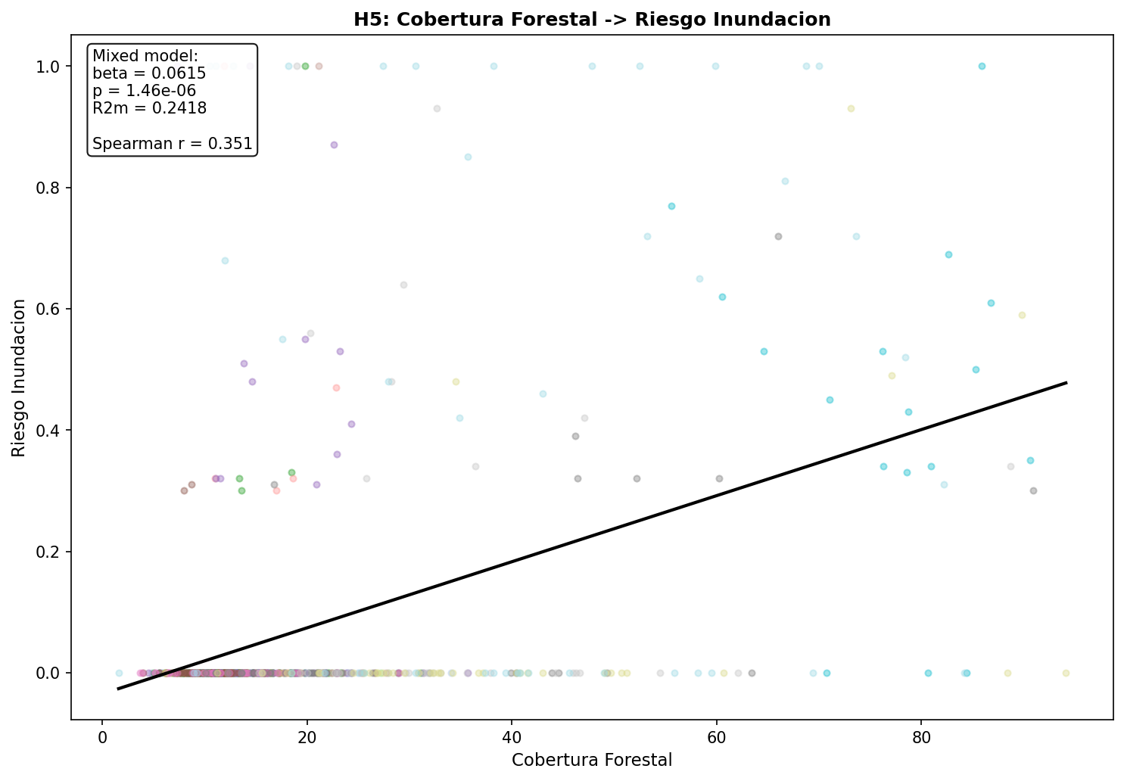
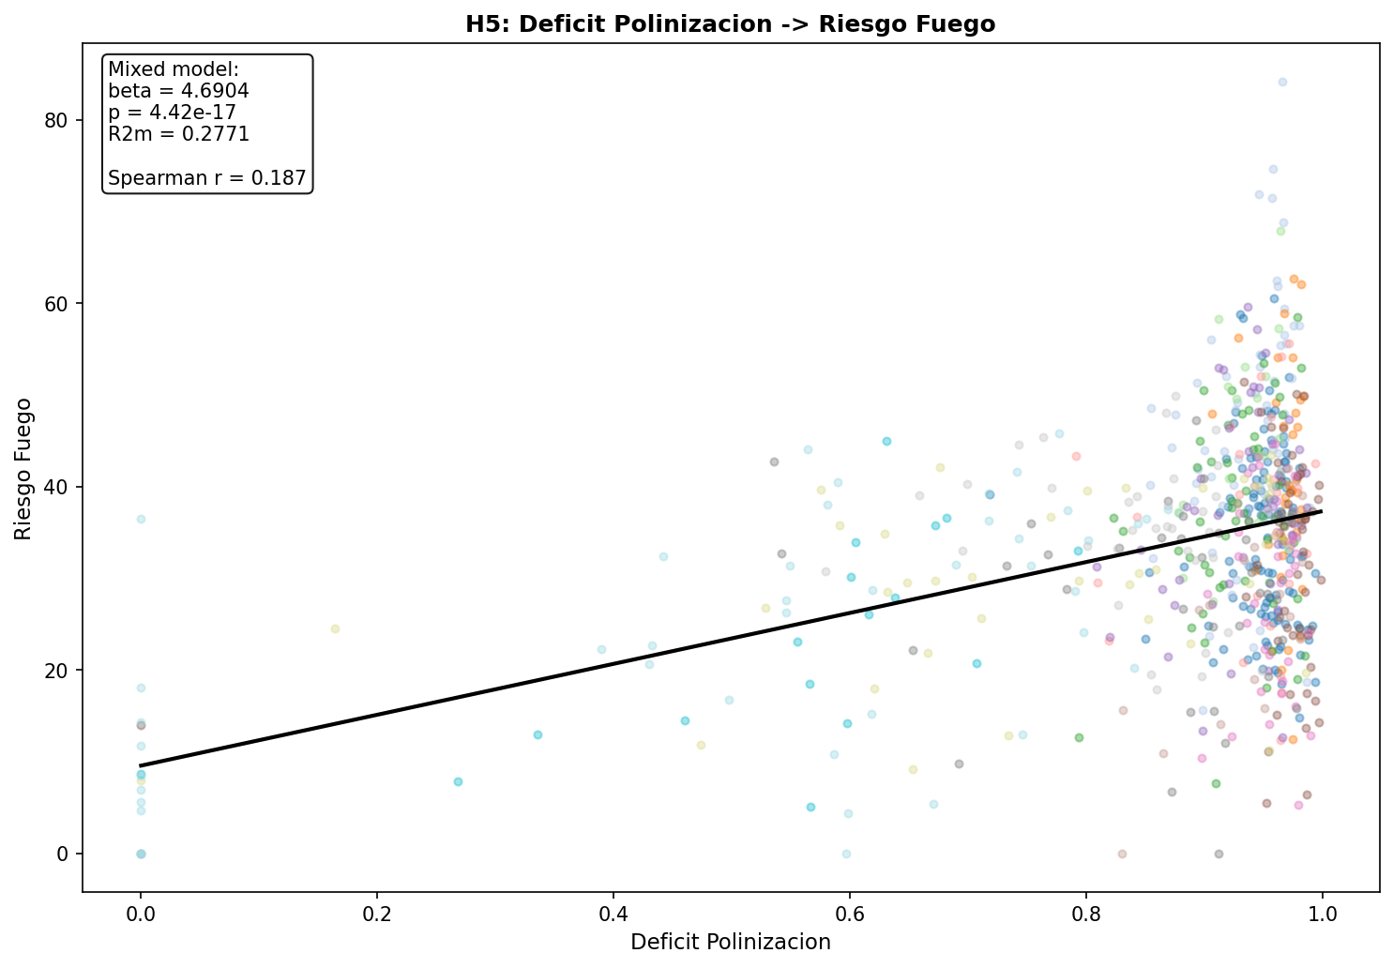
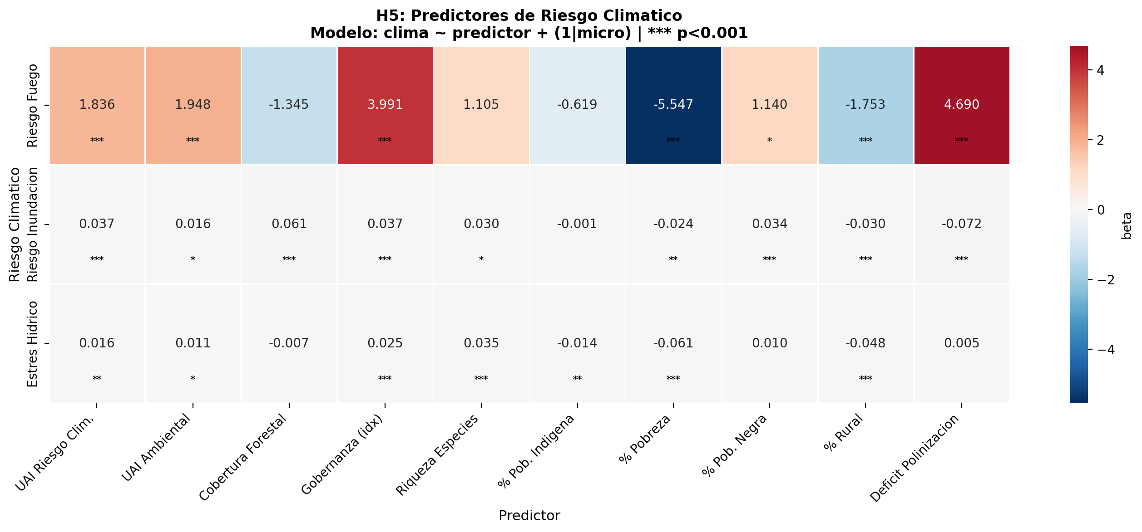
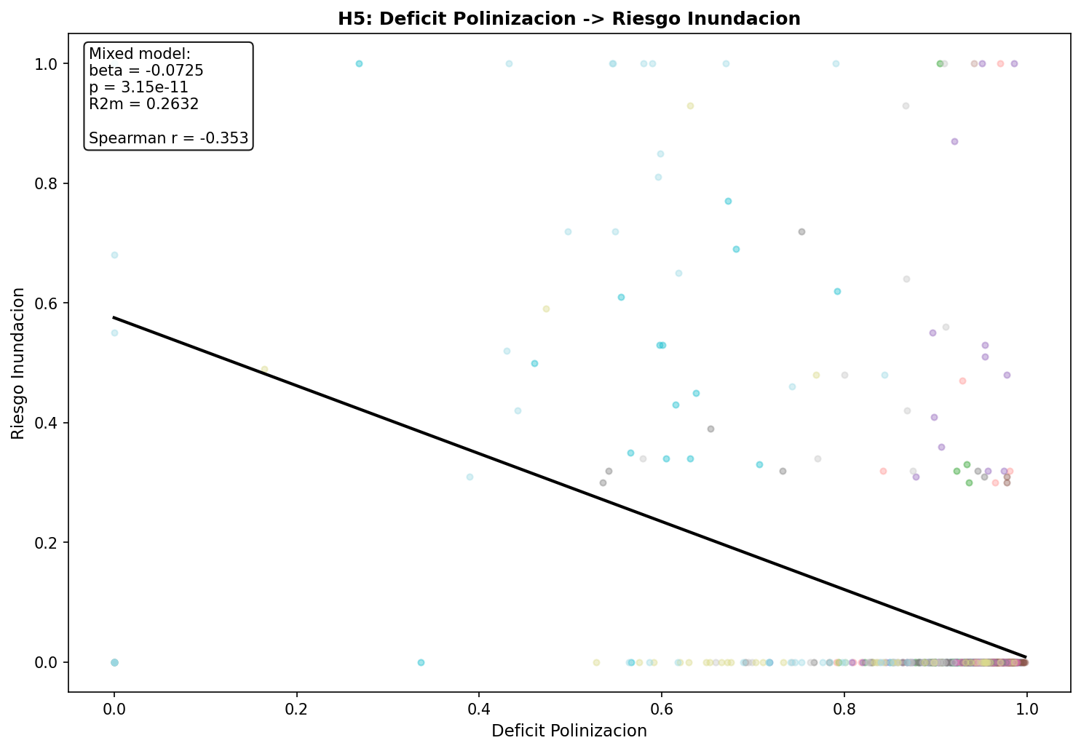
7) Quem prediz os riscos climáticos?
Land use changes is among the best predictor of climate hazards. Reinforcing restoration landscape planning

Slide 23
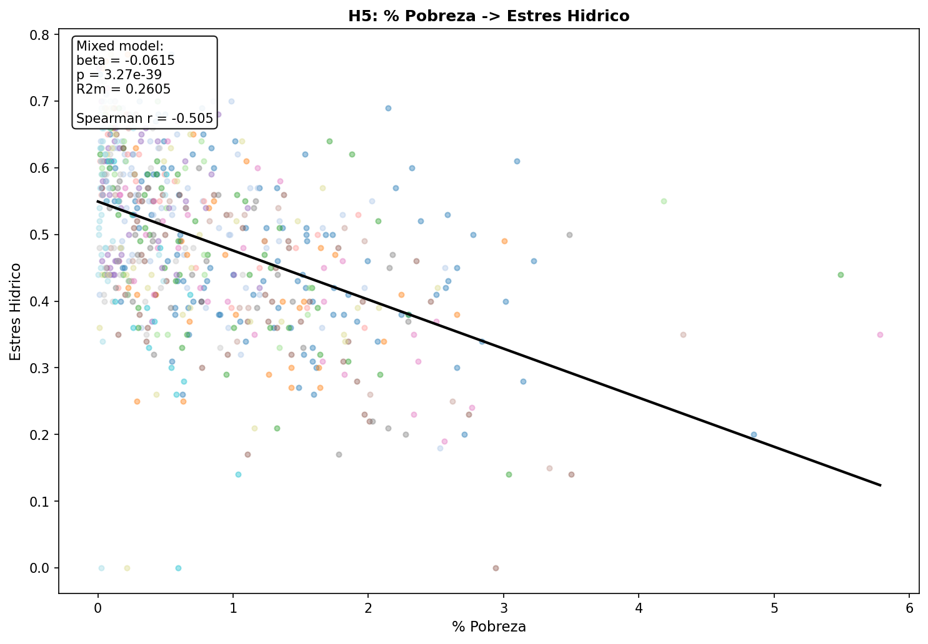
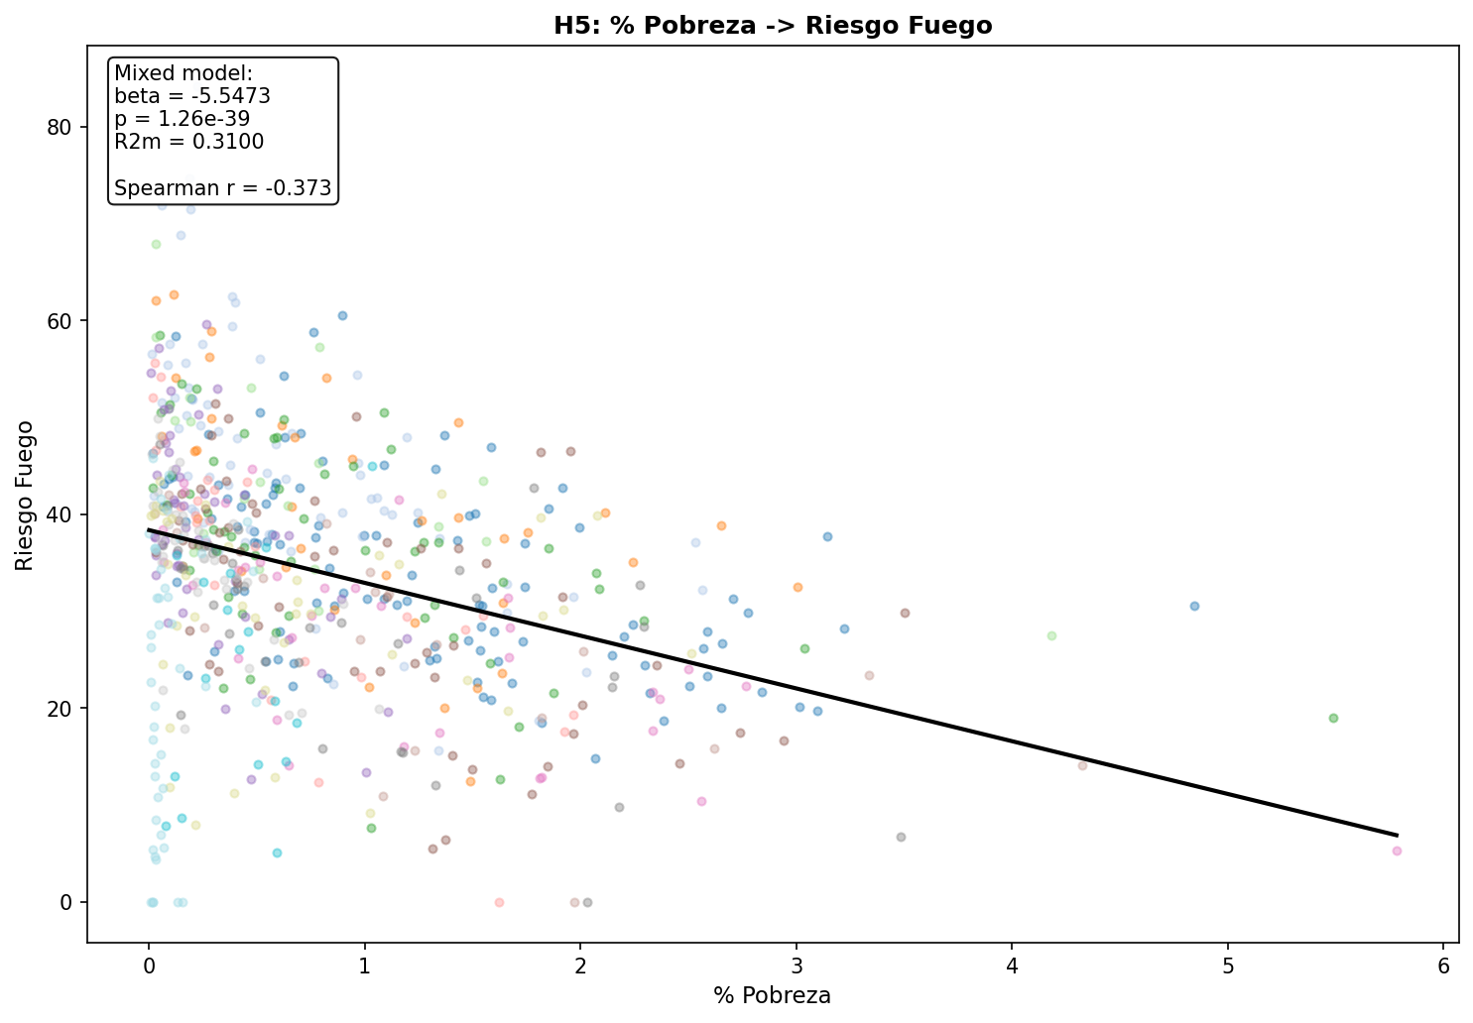
7) Quem prediz os riscos climáticos?
Locais com mais pobreza tem menos probabilidades de experimentar risco climáticos

Slide 26
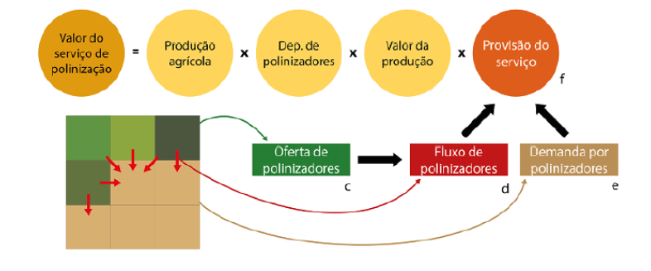
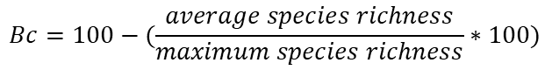
Biodiversity crisis (Bc):
Biodiversity crisis
1)We use a global model that estimates vertebrate species richness at a 1km² resolution.
We calculated average values for each municipalities in addition to maximum values. Both metrics were combinate to estimate the percentage of local extinctions. In which high percentage values represent low local average in relation to maximum values present at the municipality:
$$Bc=100−(\frac{average species richness}{maximum species richness}∗100)$$
2) Biodiversity also underpins important ecosystem services crucial for human we-being like pollination:

Slide 27
Social vulnerability:
This dimension is directly related to climate and environmental justice, defined as unequal distribution of impact and/or benefits from nature.
Specifically, we gathered:
-Percentage of families registered at the Cadastro Único with economic income equal or lower to ½ minimum wage.
-Percentage of the population that lives in either urban or rural areas.
-Number of individual self declared as either white, black or indigenous population.
Social Vulnerability

Slide 28
Climate hazards:
So far, we were able to gather data related to water stress, either flooding risk or extreme droughts:
Climate hazards
For flooding and extreme droughts events we collected information related to the overall risk, composed by three features:
+ threat which considers geophysical conditions (rain and soils)
+ vulnerability which refers economical impacts related to the climate hazard event
+ exposure, which considers the population affected.
The later (exposure) was also considered separately given it can directly relate to climate justice

Slide 29
Incidence & persistence of diseases:
We gathered data on 5 diseases zoonotic and water and food contaminated related diseases: - Malaria - Dengue - Chagas - Leptospirosis -Diarrhea
Health risks
For each disease we calculated:
Persistence between 2010 -2019
Incidence (based on population)
Co-persistence of at least two disease for each year between 2010-2019

Slide 30
Expected results:
Each dot represents one of the 645 municipalities of the São Paulo state:
Climte adaptation policy are unequally distributed among socially vulnerable sectors of society unlike climatic hazards, zoonotic diseases and pollination service
Low socio-economic vulnerability
High socio-economic vulnerability
How can policy can be improved?
Policy gap
Socio-environmental resiliency
How could policies help reduce social injustice?
Ecosystem service (provision)
Climate hazards
How could management improve service provision? Which policy are in place to do so?
Socio-environmental gap
How can policy can be improved?
Socio-environmental resiliency
Governance Adaptative capacity (UAI)
Governance Adaptative capacity (UAI)

